Slide 1
Disc and Tape Storage
Magnetic Drum:
  Drum has a magnetic surface (iron oxide)
  Small electromagnets are used known as read/write head
  Magnetization can be done in one of two directions
    North or south
  Area around the circumference of the drum is known as track
    Each head covers one track
  Can also use just one read/write head
    Moves up and down the drum’s length

Slide 2
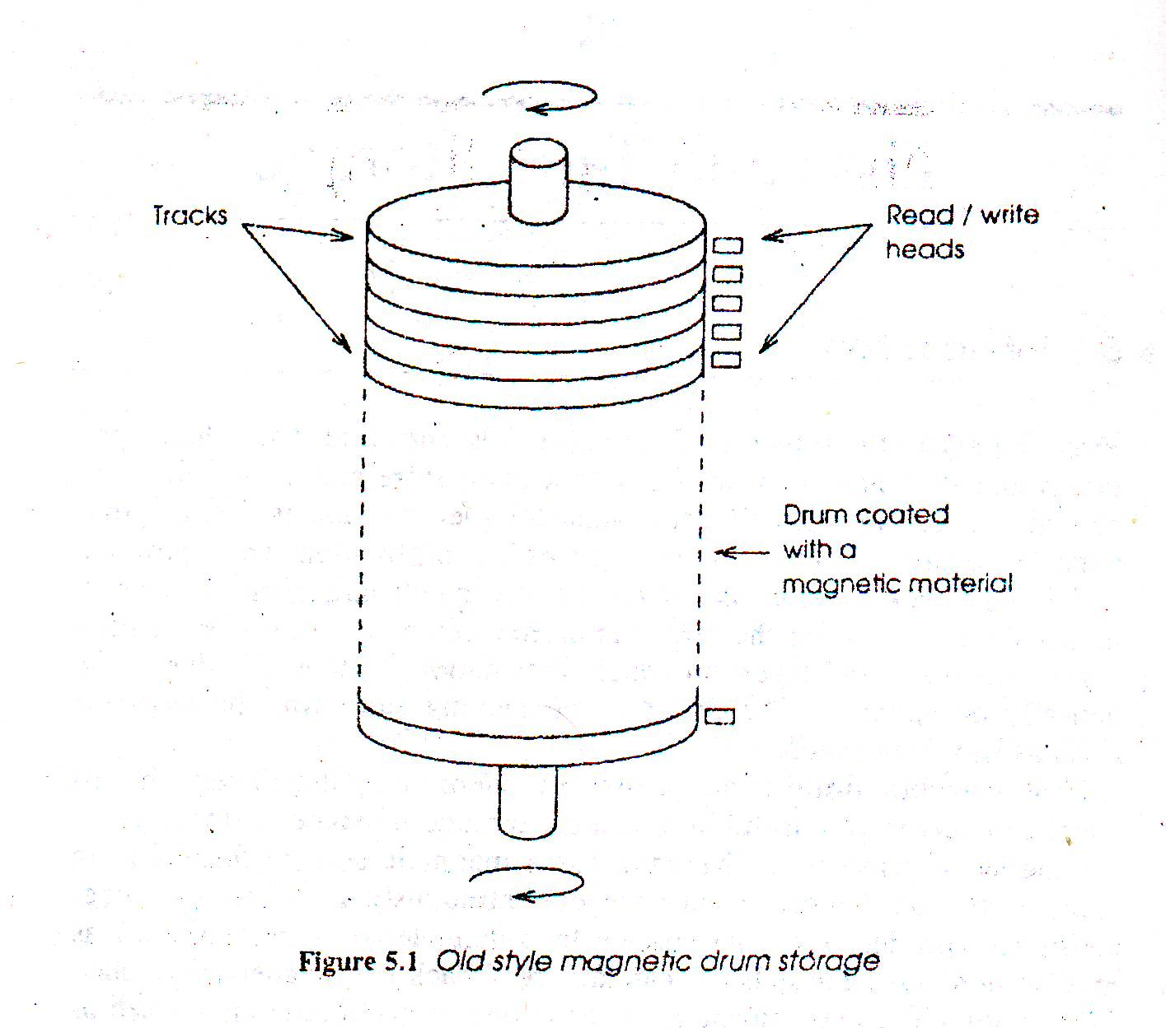

Slide 3
Recording on a Magnetic surface
Information is stored on a magnetic surface as a sequence of magnetized cells
  Each is magnetized in one direction
Writing and reading head consists of a circular core made of a material with low magnetic reluctance
Coil of wire is wrapped around the core
When current pass through the coil- magnetic flux flows around the core, the direction of which depends upon the direction of the current.

Slide 4
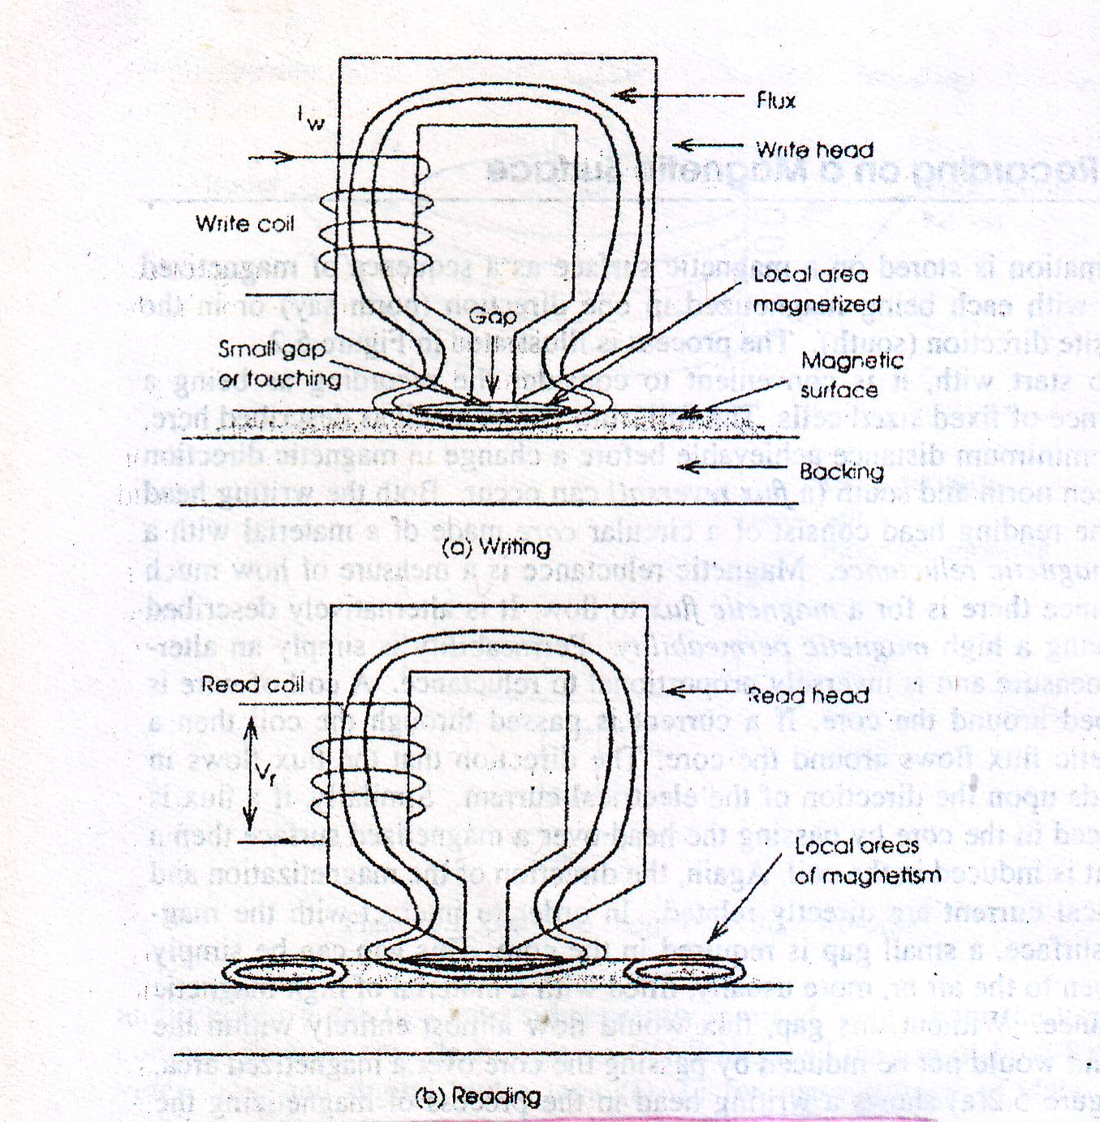

Slide 5
A small gap is required in the core in order to interact with the magnetic surface
  Usually filled with a material of high reluctance
In a writing head- magnetic flux is produced by passing current through the coil
The gap causes the flux to spread out and flow through the surface
  It magnetizes a small area of the surface(cell)
The surface moves and sequence of cells are written
Heads should have large gap
Coils should have few turns
Spacing of cells is critical

Slide 6
In a reading head- as the surface moves , a flux change in the core is detected by the induced voltage in the coil
This voltage is proportional to the rate of flux change
Heads should have large gap
Coils should have a large number of turns
This process of recording is known as Horizontal recording
It permits both sides to be recorded independently and it is technically simpler and cheaper

Slide 7
There is another process of recording which is known as Vertical recording
In this type of recording magnetic cells are created through the thickness of the medium
  North pole on one surface and south pole on the other
It is not commonly used
  Suitable magnetic medium is difficult to produce
  No hard disks currently employ this technique

Slide 8
Magnetic Disc Formats
Surface:
There are two surfaces of a circular magnetic disc
Information is stored on both surface
Track:
Information is stored on tracks
Sector:
sector is the subdivision of track
Each track is divided into equal sized lengths by sectoring

Slide 9
Tracks near the Edge of the disc are longer than those near the centre
  Each track stores same amount of information
  Each unit of information on the surface has an address consisting of two components
  track number
  sector number
  Within each unit there is space for 128,512 or 1024 bytes

Slide 10
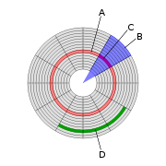
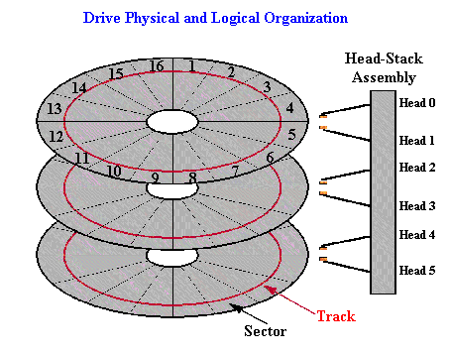
(A) Track
(B) Geometrical sector
(C) Track sector
(D) Cluster

Slide 11
  Seek time:
  In order to transfer information- head has to be positioned over the required track. This is called seeking and the time it takes is called seek time
  Latency:
  the disc unit waits for the required sector of the track to appear under head. The time lag it creates is called latency
  Disc access time= seek time + Latency + transfer time
  If sectors size is so small that individual bytes can be accessed ?
  Two problems:
  Additional control and positional information will occupy large amount of disc space
  Dominates actual transfer rate

Slide 12
Block:
One sector of one track is called a Block
Large block size increases effective efficiency of the surface
Space will be wasted when smaller size is actually required
Cylinder:
Collectively all the tracks – one per surface- that are addressed simultaneously are termed a cylinder

